Slide 1
EP Kabonde Rykene

Slide 2
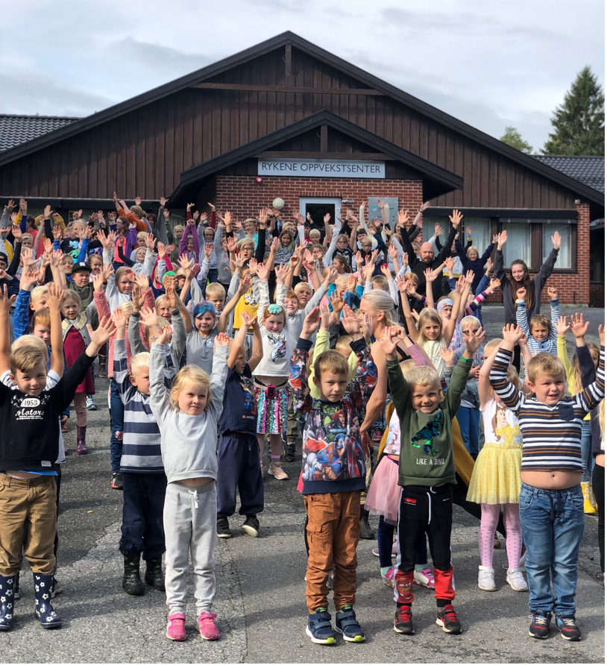
The schools
EP Kabonde
Rykene

Slide 3
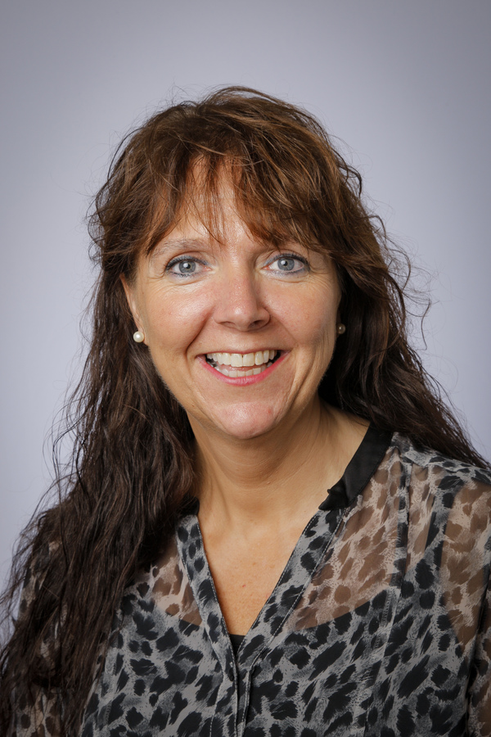
Headmasters
Gustave Murhula Shamungabo
Linda Fagermo Hjørnevik

Slide 4
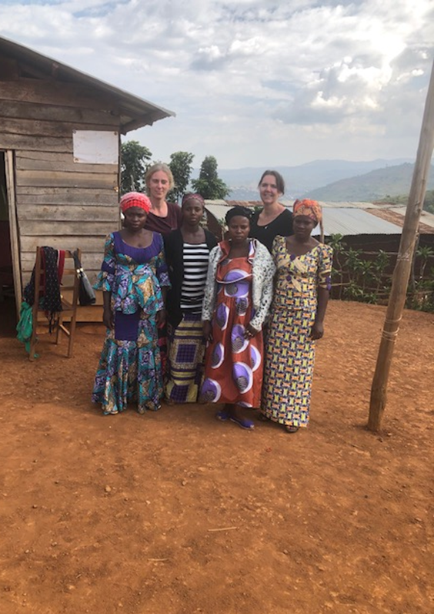
The teachers at EP Kabonde

Slide 5
The teachers at Rykene

Slide 6
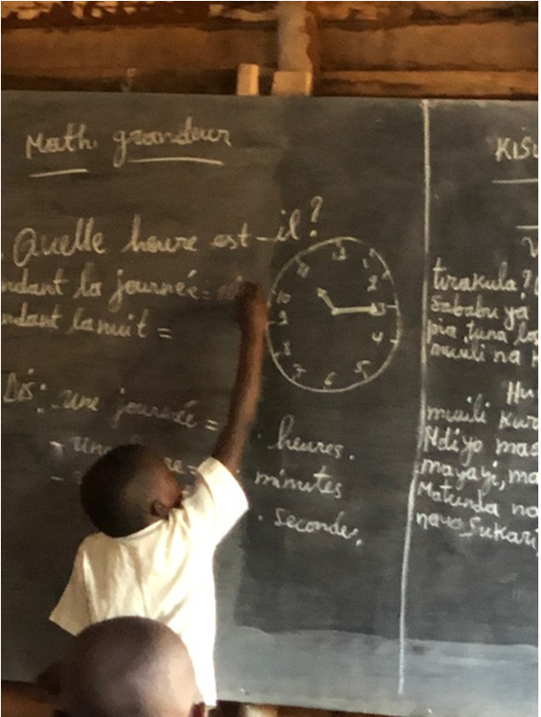
Classroom

Slide 7
New classroom at EP Kabonde

Slide 8
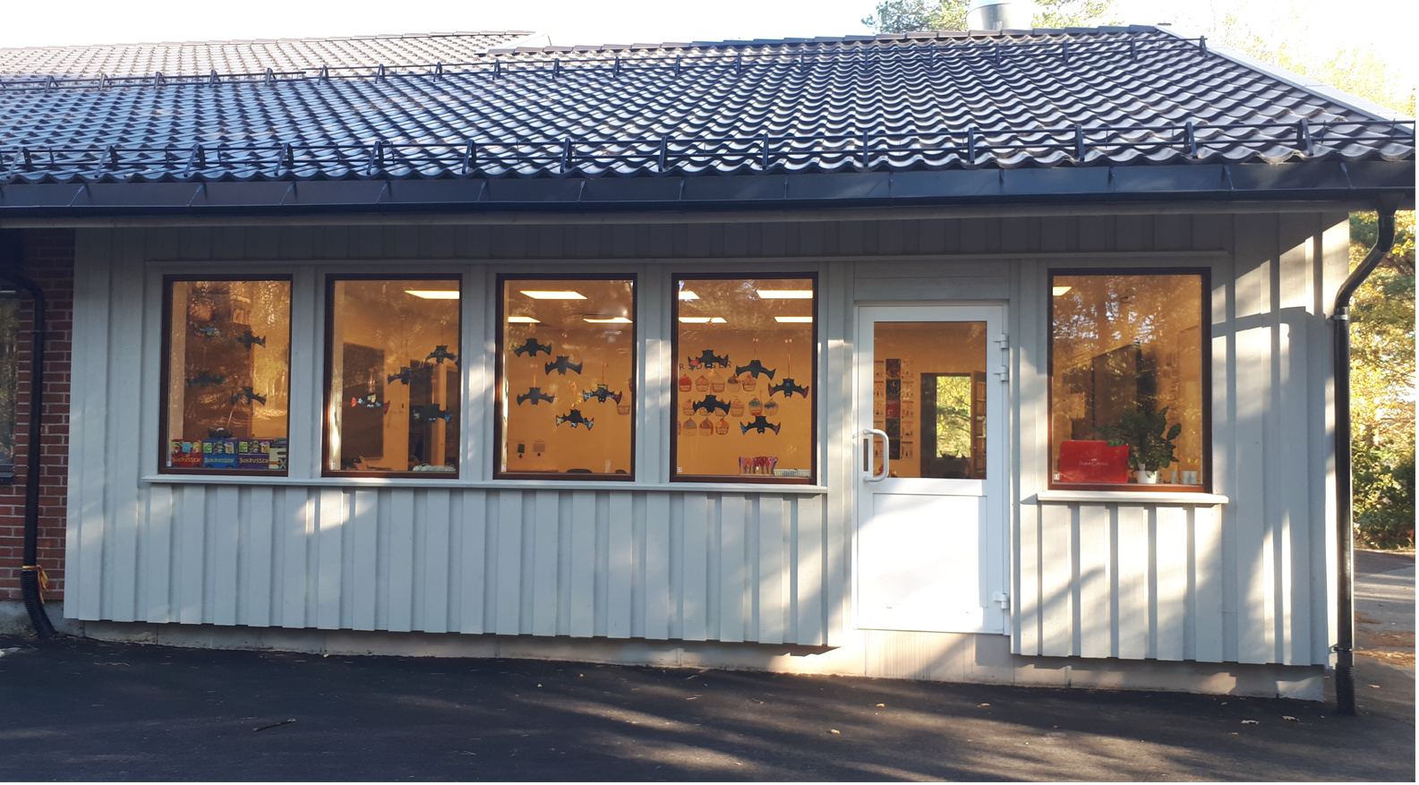
New classroom at Rykene

Slide 9
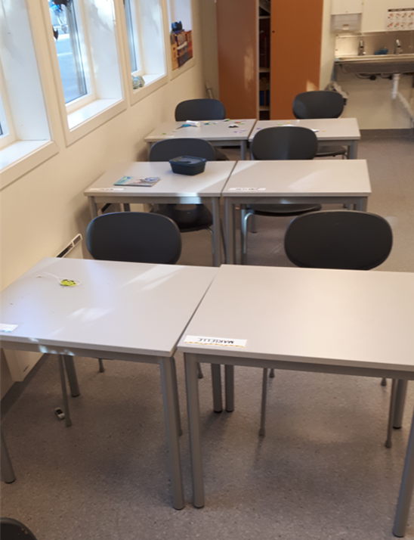
New desks at both schools

Slide 10
Curriculum planner

Slide 11
Break time EP Kabonde

Slide 12
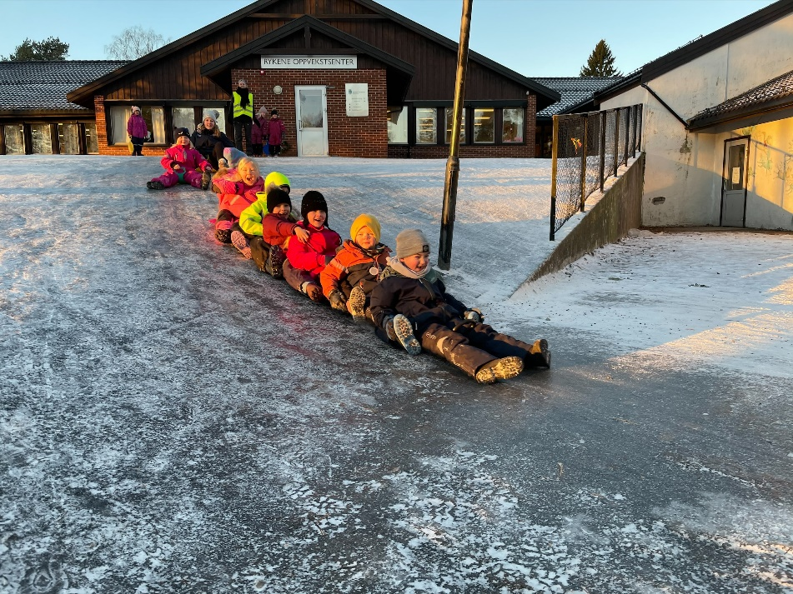
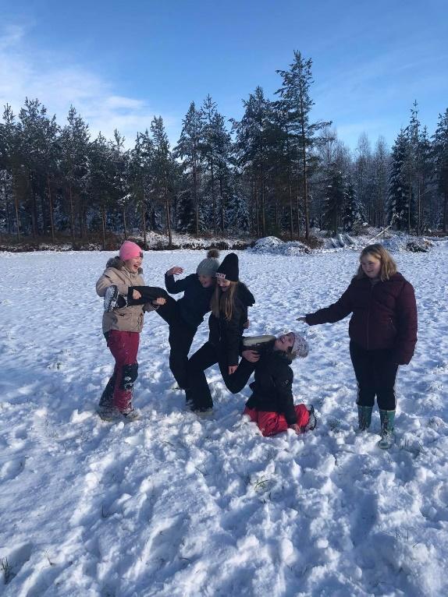
Break time Rykene

Slide 13
Arts and crafts

Slide 14
Nature EP Kabonde

Slide 15
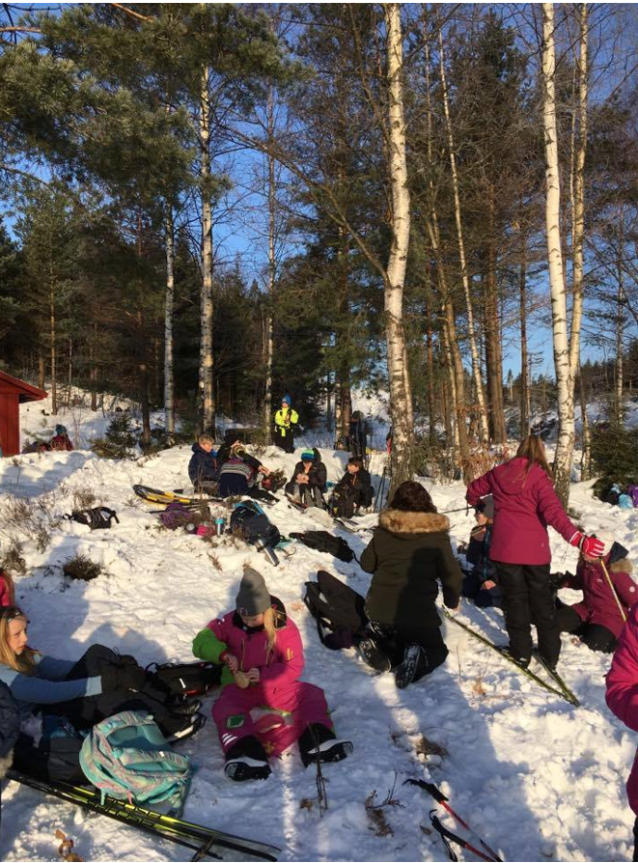
Nature Rykene

Slide 16
https://nrksuper.no/blime-dans/f3bf7ff4-13b8-4078-b21c-c8504a426cc2

