Slide 1
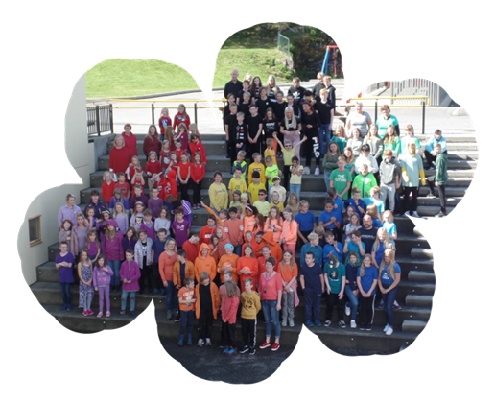
Seim skule - ein skule for framtida
Leik - læring - meistring
Presentasjon av Seim skule
Notes:
Seim school
The flower with all the pupils is our symbol
We want the school to prepare the children for the future
We focus on learning by beeing active by playing and achievements.

Slide 2
Seim skule
Notes:
This is the school – it is farely new – opened in 2013
It is a very small school compared to your schools in Bukavu.

Slide 3
Seim skule ligg i Seim syd i Alver kommune
Notes:
The school is located in Alver municipality, half an hour drive from Bergen.
The school is located in a rural setting.

Slide 4
Nokre tal om Seim skule inneverande skuleår:
Nytt skulebygg hausten 2013: Seim og Festo skule blei slått saman til ein skulekrins.
Skuleåret 2021/2022: 147 elevar - 7 klassar
1. klasse: 17 elevar
Lærarar: 15 fast tilsette
Pedagogiske medarbeidarar: 9 + 1 lærling
Inspektør: 1 i 55% stilling
Rett i underkant av 40 elevar på SFO
Notes:
This year we have 147 pupils, 7 classes and 15 teachers.

Slide 5
Fokus på trygt og godt skulemiljø
Notes:
What we focus is
that school is a safe place to stay for all the pupils
that they have a good time at school – playing and learning
and that they have many friends in school

Slide 6
Fokus på elevinvolvering - Samling i amfiet ein gong i månaden. Klassane tek ansvar for kvar si samling - «Kom og leik» Ca. 20 elevar frå mellomtrinnet blir aktivitetsleiarar kvart år - Utlånsskur – elevane har ansvar på tur - Sal av mat i kantina - Elevråd
Notes:
We want the pupils to be involved in different activities:
Once a month we have a gathering with all the pupils. One class each time, is responsible for the gathering. The content varies - songs, dance, topic for discussion and so on
During the breaks, activities are organized and some of the oldest pupils are leaders
We have a large football court – a lot of the pupils love playing football
Those who don´t play football, can do other things

Slide 7
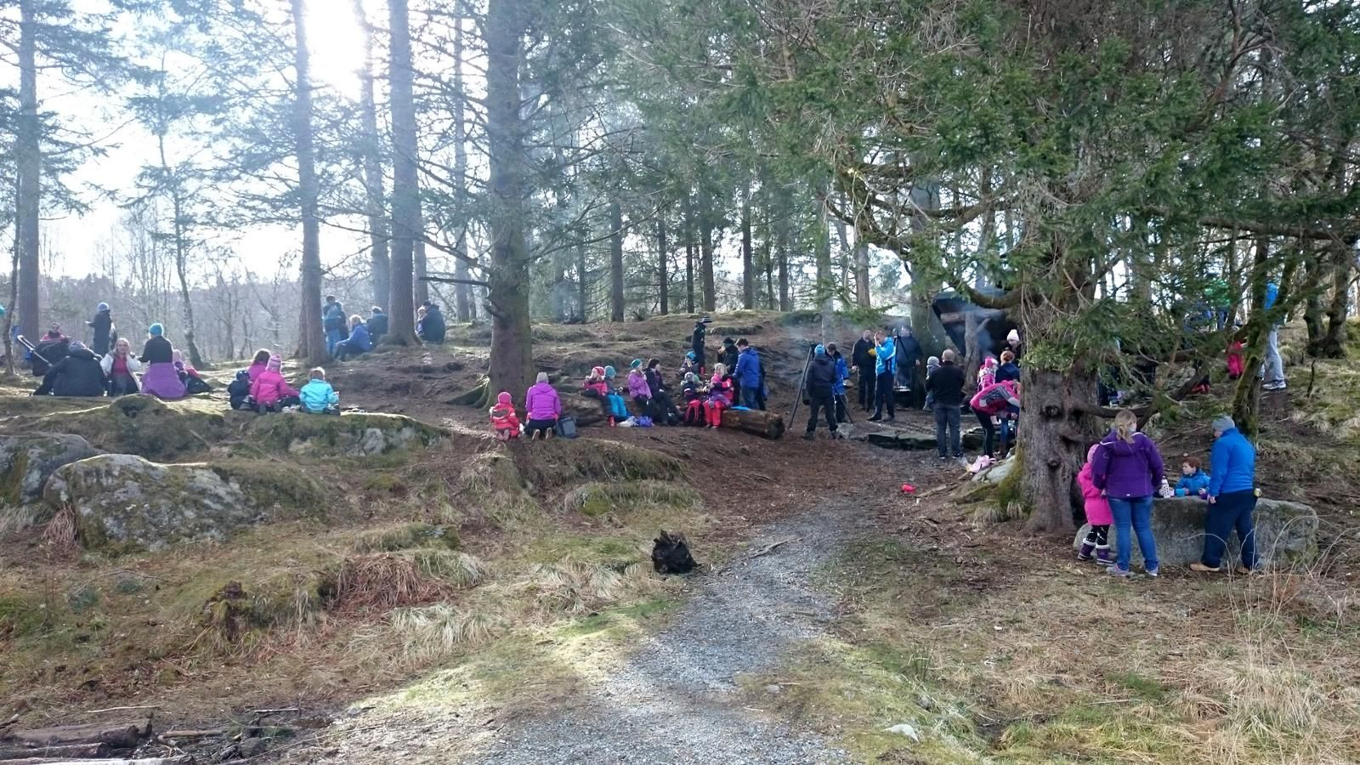
Dei yngste brukar mykje naturen som klasserom
Notes:
The youngest often use nature as a classroom

Slide 8
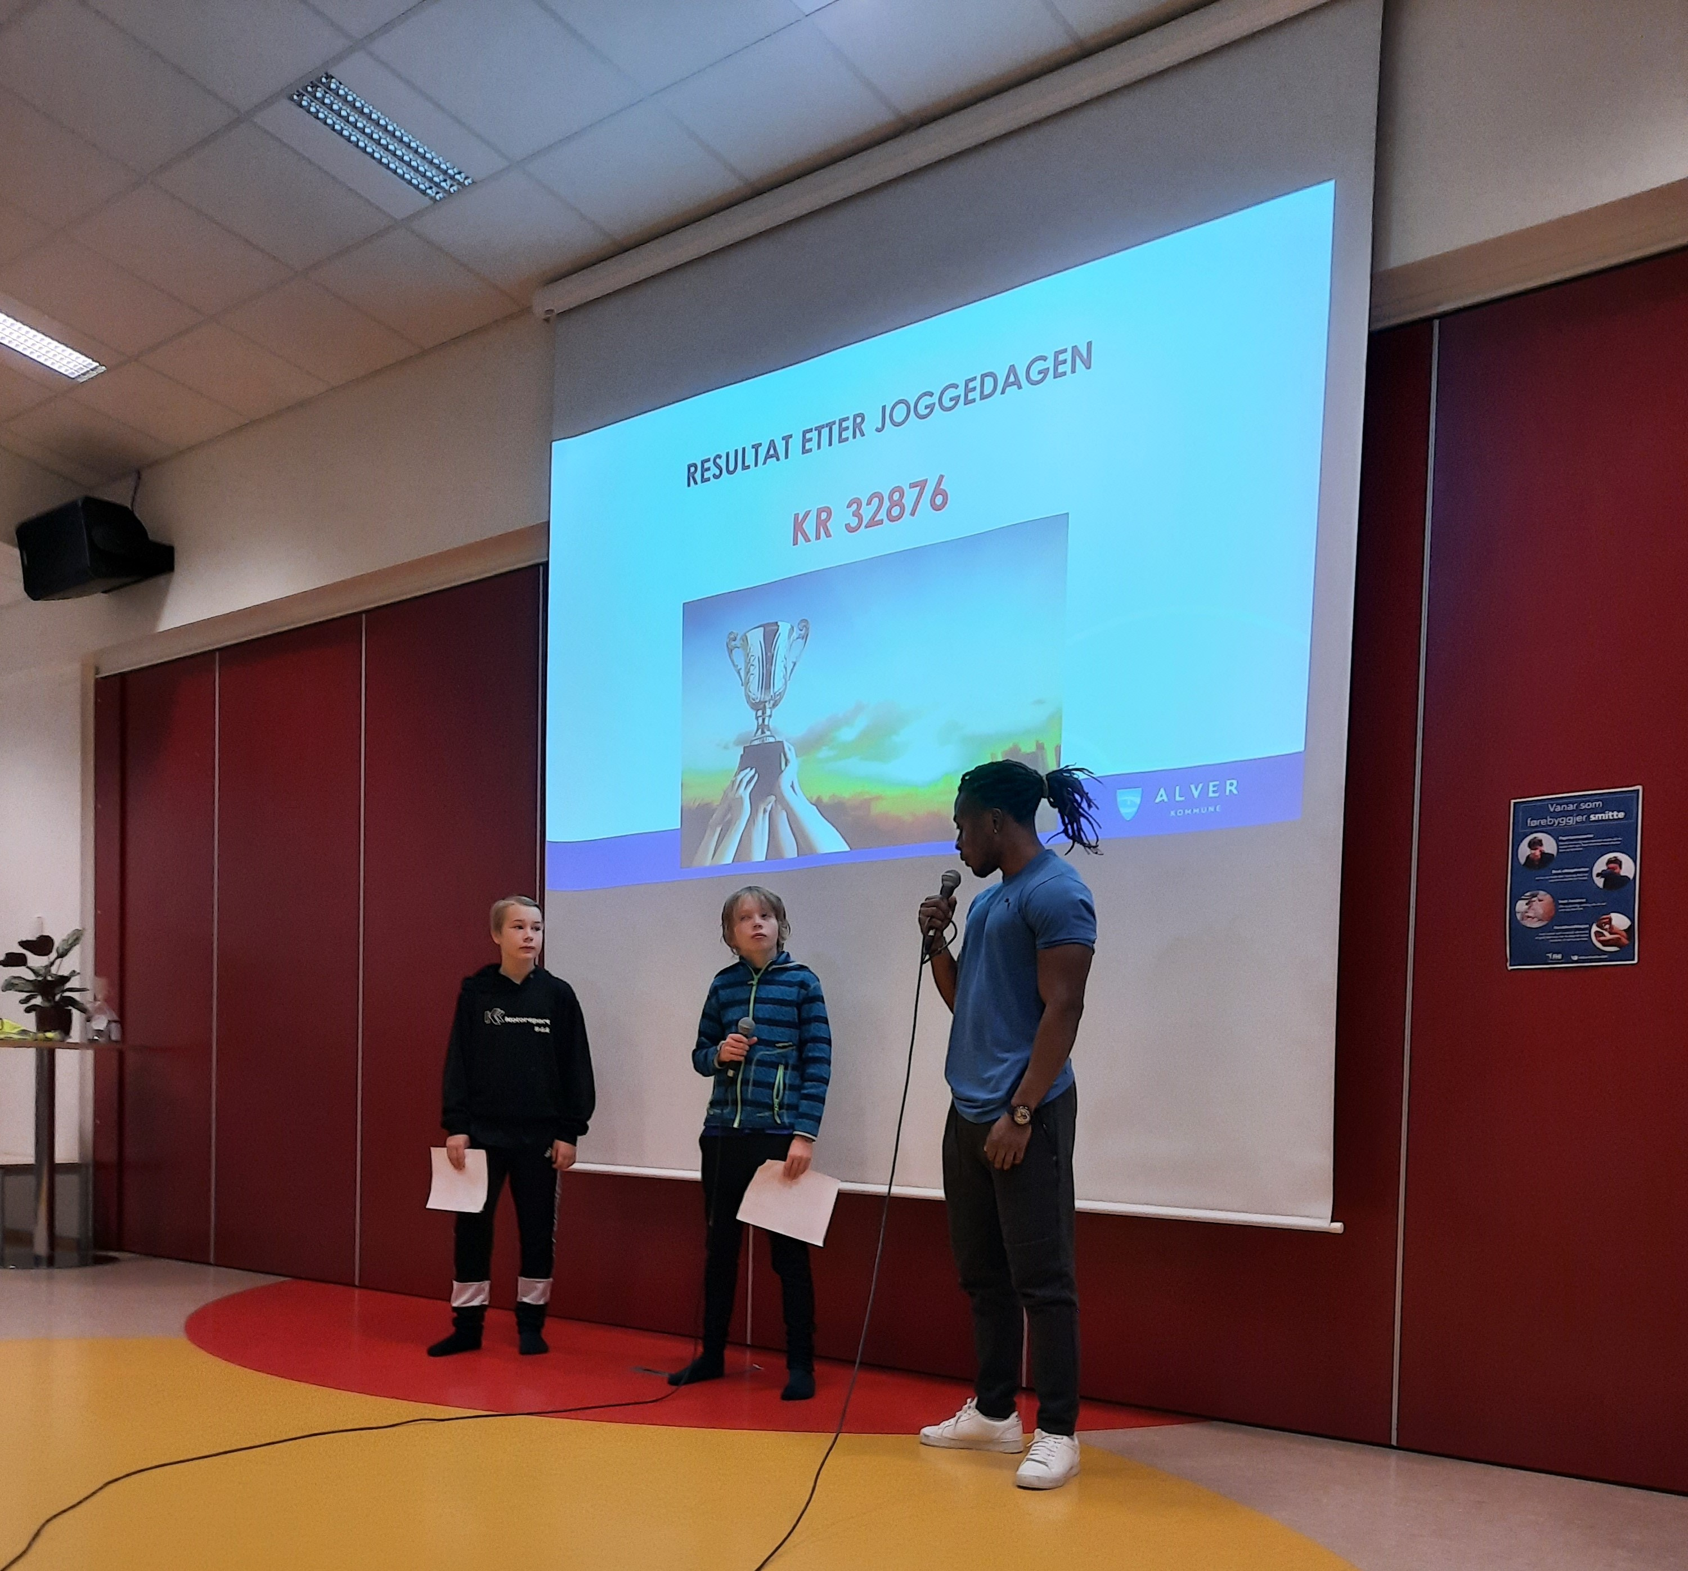
Joggedag 8.oktober 2021
Notes:
Once a year we arrange the «Jogging day» – always in October
As you know – this year Salum Kashafali was connected to the arrangment
That was very popular among the pupils

Slide 9
Klar for joggedag – alltid fredag dag før haustferien

Slide 10
Notes:
It is importent to give the parents information about the «Jogging day»
- they pay together with grandparents, aunts and uncles for the childrens participation
The aim of the participation is to rais money for a good cause
We were very happy this year to rais money for Mulambula school!
And now we also are an “Urafiki-school”
We look forward to get to know you all and to build friendship with you.

Slide 11
Læringsgropa – Learning pit
Notes:
Our «Learning pit»
I have heard that you also try to use the learning pit in your teaching.
It is important that pupils understand their own learning process
What is my goal?
Where am I in my learning process?
What do I have to do to reach my goal?

